Slide 1

LEARN PROGRAMMING WITH
KELVIN
kelvindsmn@gmail.com

Slide 2
MATERIAL
In this course we will learn about the following concepts :
Iteration
Nested Iteration

Slide 3
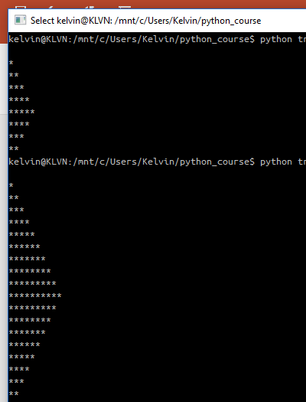
LOOP PATTERN

Slide 4
from __future__ import print_function
n = 10
for i in range(n):
for j in range(i):
print("*" , end="") # print the star
print("") #print break
for x in range(n,1,-1):
for y in range(x):
print("*" , end="") # print the star
print("") #print break

Slide 5
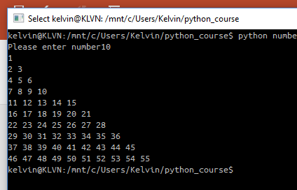

Slide 6
from __future__ import print_function
n = int(raw_input('Please enter number'))
# initializing starting number
num = 1
# outer loop to handle number of rows
for i in range(0, n):
# not re assigning num
# num = 1

Slide 7
# inner loop to handle number of columns
# values changing acc. to outer loop
for j in range(0, i+1):
# printing number
print(num, end=" ")
# incrementing number at each column
num = num + 1
# ending line after each row
print("\r")

Slide 8
PYRAMID
1 |  |  |  | *
2 |  |  | * |  | *
3 |  | * |  | * |  | *
4 | * |  | * |  | * |  | *

Slide 9
from __future__ import print_function
n = int(raw_input('Please enter how many rows'))
# number of spaces
k = 2 * n - 2
# outer loop to handle number of rows
for i in range(0, n):
# inner loop to handle number spaces
# values changing acc. to requirement
for j in range(0, k):
print(end=" ")

Slide 10
# decrementing k after each loop
k = k - 1
# inner loop to handle number of columns
# values changing acc. to outer loop
for j in range(0, i+1):
# printing stars
print("* ", end="")
# ending line after each row
print("\r")

